Slide 1


Don Bosco Institute of Technology
Department of Electronics and Communication Engineering
Internship Report On
AUXILIARY GATE CONTROLLER MODULE FOR TRACTION
Presented by
APOORVA M - 1DB20EC007
Guided By
Prof .SURESHA H S
Associate Professor
Dept. of ECE, DBIT

Slide 2
CONTENTS
INTRODUCTION
GATE CONTROLLER MODULE FOR TRACTION
Essentials of Auxiliary Gate Controller
Hardware
Testing Procedure for AG3AA With result
CONCLUSION
REFERENCES

Slide 3
INTRODUCTION
Bharat Heavy Electricals Limited (BHEL) owned and founded by the Government of India, is an engineering and manufacturing company based in New Delhi, India. Established in 1956, BHEL is India’s largest power generation equipment manufacturer.
BHEL was established in 1956 ushering in the indigenous Heavy Electrical Equipment industry in India. Heavy Electricals (India) Limited was merged with BHEL in 1974. In 1991, BHEL was converted into a public limited company. Over time, it developed the capability to produce a variety of electrical, electronic and mechanical equipments for all sectors, including transmission, transportation, oil and gas and other allied industries.
BHEL is engaged in the design, engineering, manufacturing, construction, testing, commissioning and servicing of a wide range of products, systems and services for the core sectors of the economy, viz. power, transmission, industry, transportation, renewable energy, oil & gas, and defence.

Slide 4
AUXILLARY GATE CONTROLLER MODULE FOR TRACTION
An auxiliary gate controller module for traction typically refers to a component used in electric traction systems, such as those found in electric vehicles (EVs) or electric trains. This module controls auxiliary functions and subsystems, like heating, ventilation, air conditioning (HVAC), lighting, and other non propulsion systems.
It ensures efficient operation and management of these auxiliary systems within the overall traction system, helping to optimize energy usage and maintain passenger comfort. In the 6000HP Locomotives, Auxiliary Converters are used to supply three phase Auxiliary load and charge the 110VDC Battery.
The Auxiliary converter units are mounted in the Machine room of the locomotive and are forced cooled. Each locomotive is equipped with identical three converters (Bur1, Bur 2 and Bur 3) each rated at 130KVA.
The Auxiliary converters are powered through a separate secondary winding of the traction transformer. Input to the Auxiliary Converter is 1000VAC, 1ph, 50Hz. The output of the Auxiliary converter is 415VAC, 3Phase and 110VDc.

Slide 5
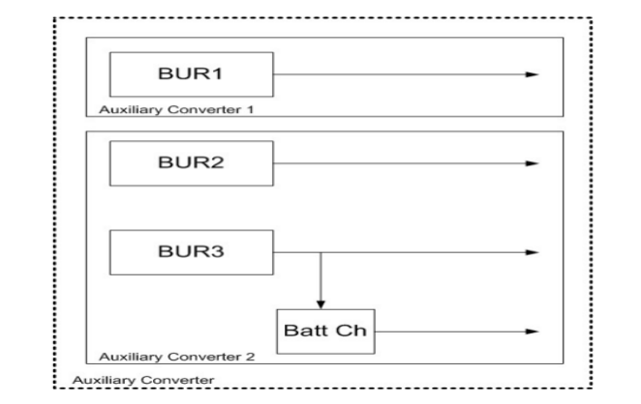
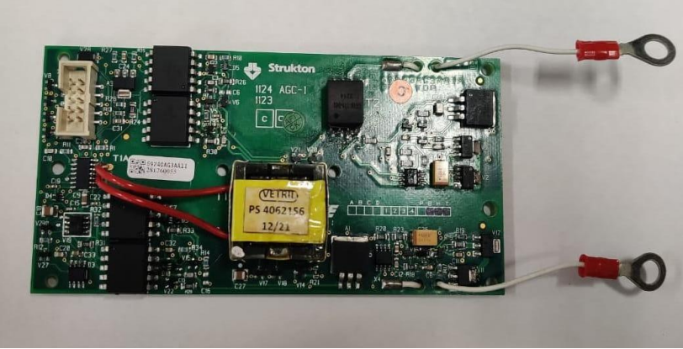
Single phase input terminals
Controlled rectifier (Fully-controlled Thyristor Bridge)
DC-link inductor
High Voltage indicator
Buffer capacitor (Electrolytic capacitor)
Over-voltage protection for the DC-link, with automatic crow-bar
Three-phase IGBT-based 130KVA inverter with Discharge resistor.
Three-phase output filter
Auxiliary Controller Interface
Three-phase output terminals

Slide 6
Essentials of Auxiliary Gate Controllers
Safety : Auxiliary gate controllers help manage access to critical areas like tracks, maintenance zones, or electrical substations, preventing unauthorized personnel from entering these potentially hazardous locations.
Access Control :Traction systems often have restricted areas that only authorized personnel should enter.
Security :Protecting the infrastructure of a traction system is vital.
Operational Efficiency :Gate controllers is particularly important in busy transit hubs or maintenance yards.
Data Logging :Many auxiliary gate controllers are equipped with data logging capabilities.
Integration :These controllers can be integrated with other systems within the traction infrastructure, such as security cameras, to create a comprehensive and interconnected safety and security network.

Slide 7
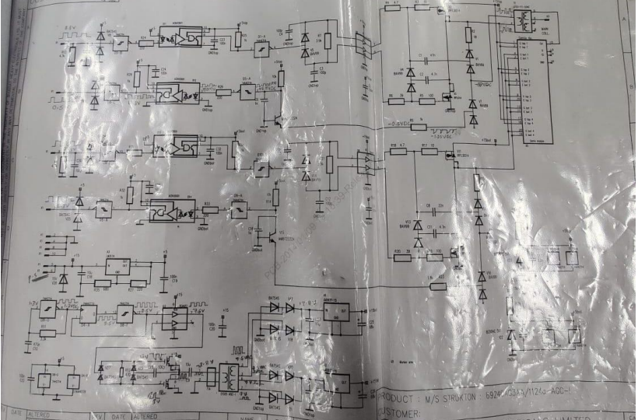
Hardware
Resistor
Capacitors
Semix module
BAT54S
ACNV2601
74HCT14
BAV99
TC4426/TC4427/TC4428 41
IRFL014
MMBT2222A
74AHCT14
SEMiX family

Slide 8
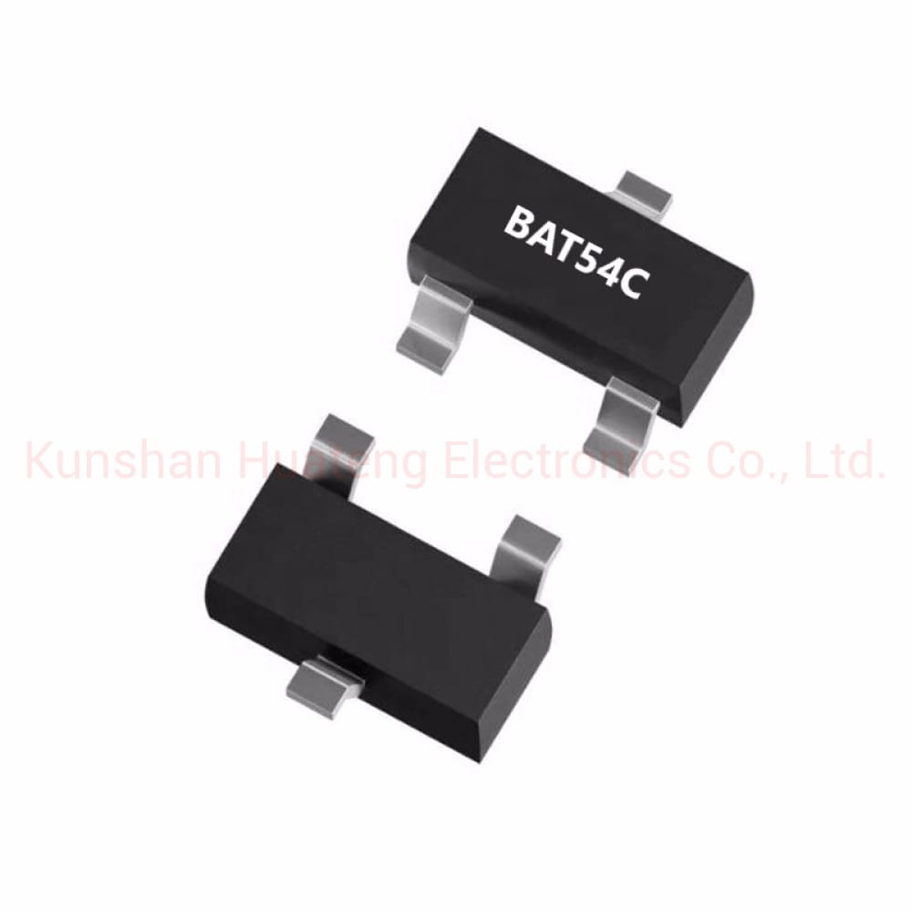
BAT54S
The BAT54S is a Planar Schottky barrier diode with an integrated guard ring for stress protection, encapsulated in a small SOT23 (TO-236AB) Surface-Mounted Device (SMD) plastic package. This series comes in different part numbers: BAT54, BAT54C, BAT54A

Slide 9
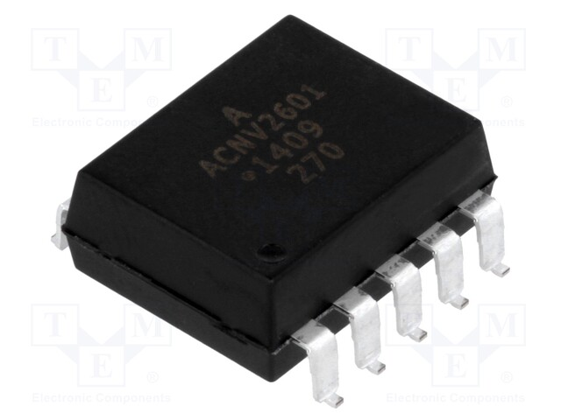
ACNV2601
The ACNV2601 is an optically coupled gate that combines a AlGaAs light emitting diode and an integrated photo detector housed in a widebody package. The distance-through-insulation (DTI) between the emitting diode and photo-detector is 2mm. The output of the detector IC is an open collector Schottky clamped transistor.

Slide 10
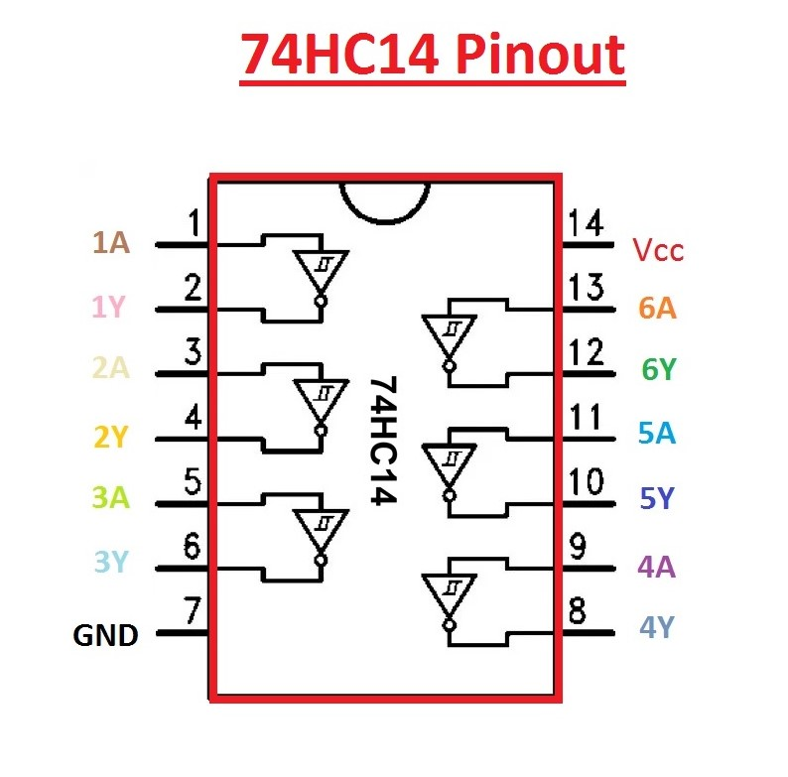
74HCT14
The 74HCT14 provides provides six independent Schmitt trigger input inverters with standard push-pull outputs. The device is designed for operation with a power supply range of 4.5V to 5.5V. The gates perform the Boolean function: AY.

Slide 11
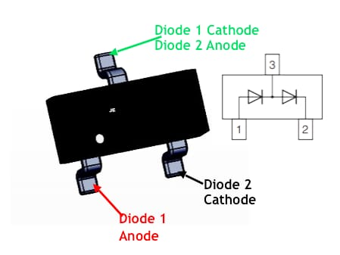
BAV99
The BAV99 is a surface mount dual Small Signal Switching Diode encapsulated in a moulded plastic case. It has matte tin (lead-free plating) annealed over alloy 42 lead frame terminals. It is ideally suited for automated insertion. It can also be used for general purpose switching applications.

Slide 12
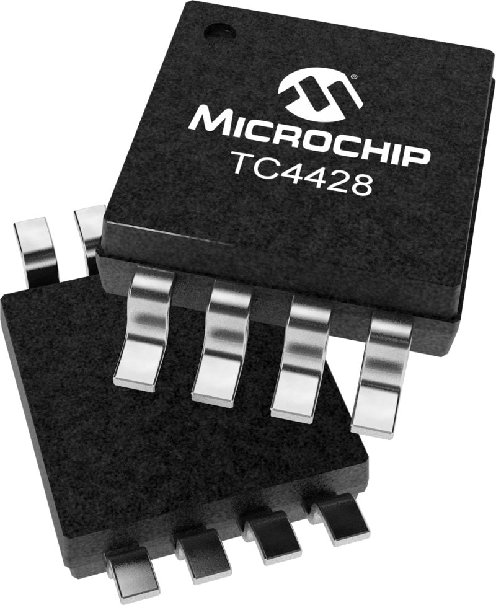
TC4426/TC4427/TC4428
The TC4426/TC4427/TC4428 devices have matched rise and fall times when charging and discharging the gate of a MOSFET. These devices are highly latchup resistant under any conditions within their power and voltage ratings

Slide 13
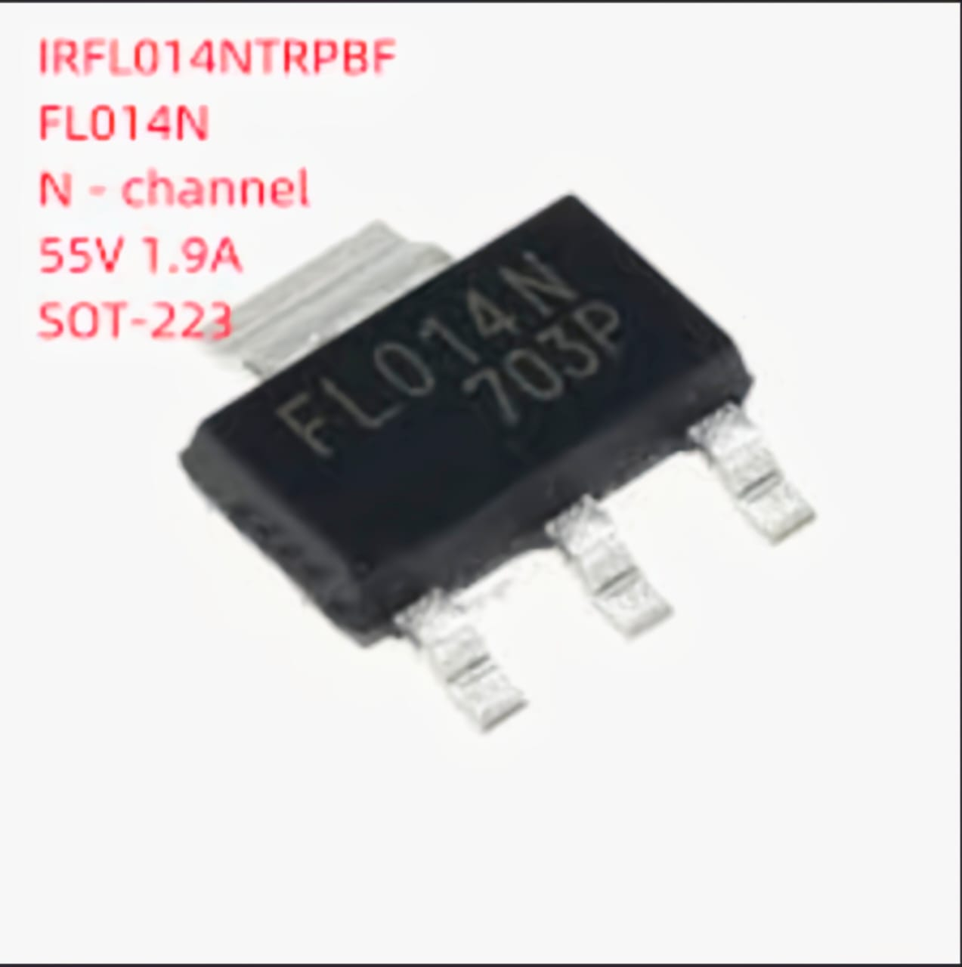
IRFL014
Third generation power MOSFETs from Vishay provide the designer with the best combination of fast switching, ruggedized device design, low on-resistance, and cost-effectiveness. The SOT-223 package is designed for surface-mounting using vapor phase, infrared, or wave soldering techniques

Slide 14
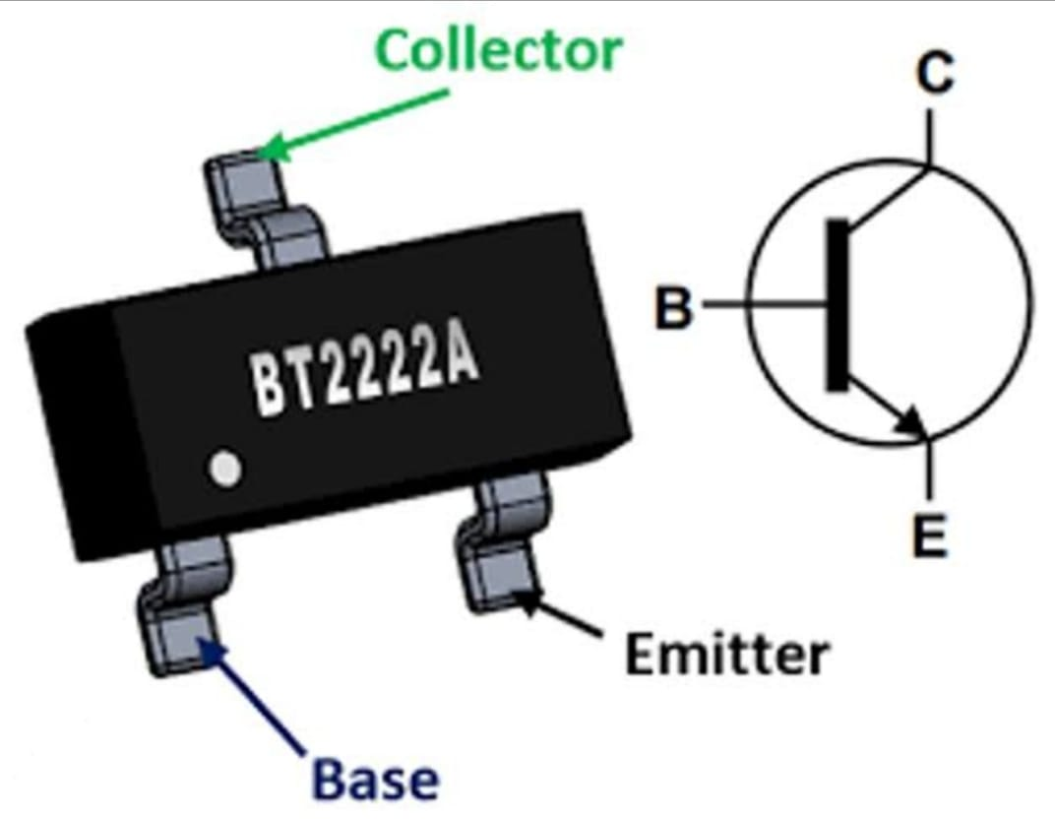
MMBT2222A
The MMBT2222A from Fairchild is a surface mount, NPN general purpose amplifier in SOT-23 package. This device is suitable for medium power amplification and switching applications.

Slide 15
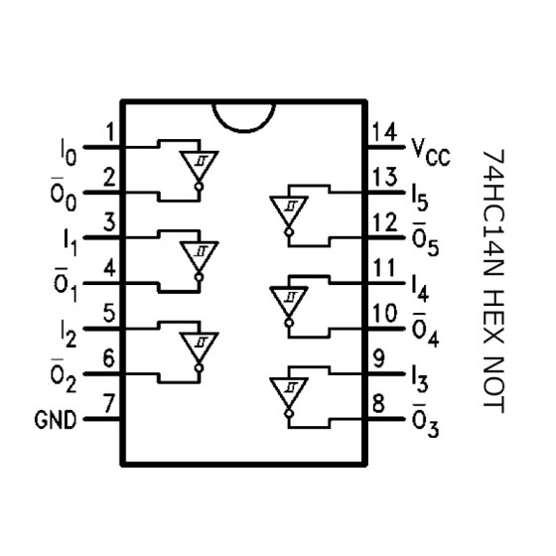
74AHCT14
74AHCT14 is a hex inverter with Schmitt-trigger inputs. Inputs are overvoltage tolerant. This feature allows the use of these devices as translators in mixed voltage environments.

Slide 16
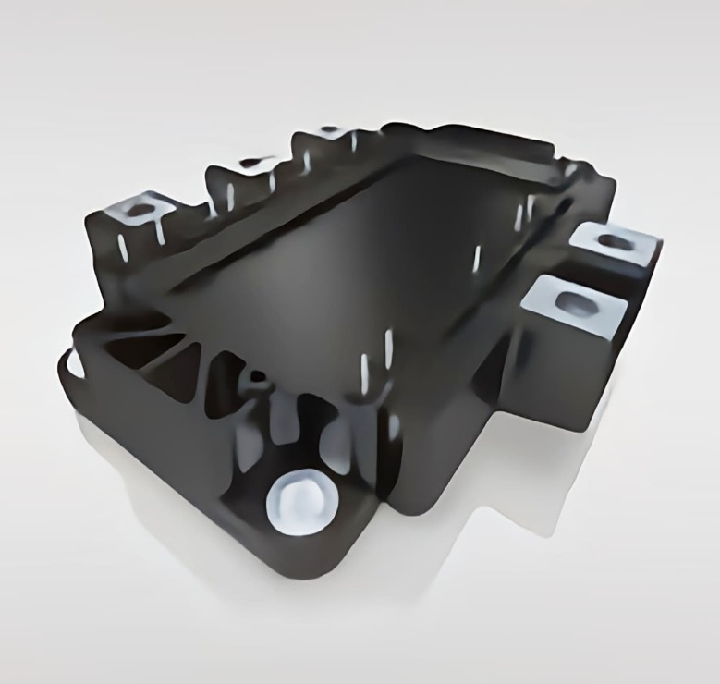
SEMiX Family
The SEMiX family includes uniform IGBT and rectifier housings. Virtually all have the same height (17mm) and the power terminals can be connected by one principle DC-link design. This saves development time and makes a simple, low inductance DC-link profile possible.

Slide 17
Testing Procedure for AG3AA With result
This test for the Auxiliary IGBT driver (1123 AGCI) PCB. The routine test consists of the following steps:
• Visual inspection
• Performance test
• Burn in
• Performance test
Test Procedure
Switch ON to OFF
place the PCB under test on the test box. Secure it with a nut in the center.
connect the connector x1
connect the appropriate connection points on the test box with two cable lugs.
Fasten. the nuts Chard tight
put switch s2 to 1,S3 to E

Slide 18
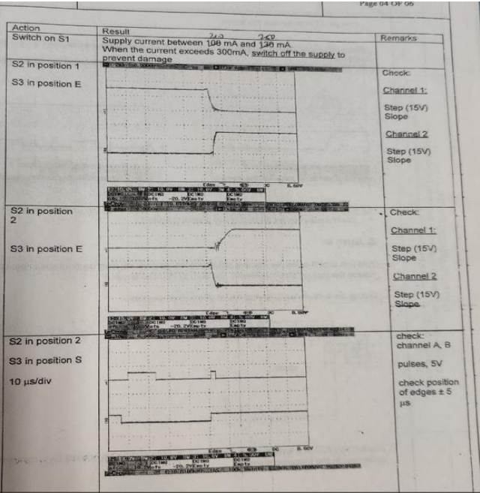
Test Result

Slide 19
CONCLUSION
From our Internship at BHEL EDN, we were able to get better understanding about various electrical machines, electronic equipments, traction converters for Indian Railways. Their working principles .We also learned a lot about the company’s workplace culture, the industrial, the industrial setting, and the entire manufacturing process.
This experience helped me think in a different way about solving problems. We learned the importance of paying attention towards the teamwork ,communication and constructive attitude.
I also learnt to Practice teamwork in the course by identifying the roles, managing conflict, and participating in problem solving and finding out the better solutions related to their jobs. Not only they shared us the knowledge related to manufacturing the parts but also taught us the basic employability skills to sustain in a factory through completing the course, acting professionally and prioritizing duties.

Slide 20
REFERENCES
www.bhel.com
www.edn.bhel.com
www.careers.bhel.in
www.bheledn.com
www.fresherslive.com
www.fresherworld.com

Slide 21
THANK YOU

